Slide 1
Object Oriented Programming (Introduction to Programming) Manuel Mazzara
Lecture 13a: Genericity

Slide 2
Recap on Data Structures
Use a linked list if:
Order between items matters
The main way to access them is in that order
(Bonus condition) No hardwired size limit
Use an array if:
Each item can be identified by an integer index
The main way to access items is through that index
Hardwired size limit (at least for long spans of execution)
Use a hash table if:
Every item has an associated key
The main way to access them is through these keys
The structure is bounded
Use a stack:
For a LIFO policy
Example: traversal of nested structures such as trees
Use a queue:
For a FIFO policy
Example: simulation of FIFO phenomenon

Slide 3
Generic programming
Algorithms are written in terms of ”types to-be-specified-later”
Instantiated when needed for specific types provided as parameters
Allows writing common functions or types differing only in the set of types on which they operate
It reduces duplication
ML in 1973
Generics in Ada, Delphi, Eiffel, Java, C#, F#, Objective-C, Swift, and Visual Basic .NET
Templates in C++ and D
Parametric polymorphism in ML, Scala and Haskell

Slide 4
Extending the basic notion of class
Inheritance
Abstraction
SET_OF_CARS
Genericity
Type parameterization
Type parameterization
LIST_OF_ CITIES
LIST_OF_CARS
LIST_OF_
PERSONS
LINKED_LIST_OF_CARS
Specialization
Notes:
4

Slide 5
Extending the basic notion of class
Inheritance
SET_OF_ PERSONS
SET_OF_CARS
Genericity
LIST_OF_ CITIES
LIST_OF_CARS
LIST_OF_
PERSONS
LINKED_LIST_ OF_CITIES
LINKED_LIST_OF_CARS
Notes:
5

Slide 6
Genericity: ensuring type safety
How can we define consistent “container” data structures, e.g. list of cars, list of cities?
Without genericity we hav something like what appears in the next couple of slides.

Slide 7
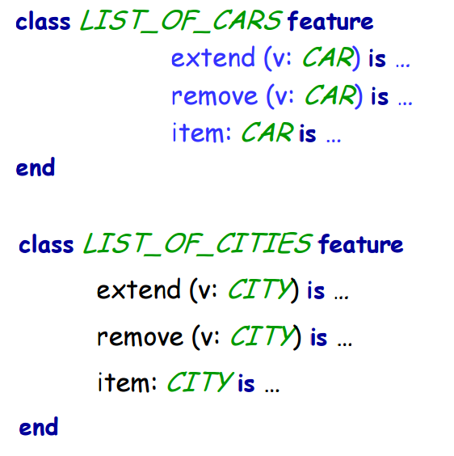
What is wrong with this code (1)?

Slide 8
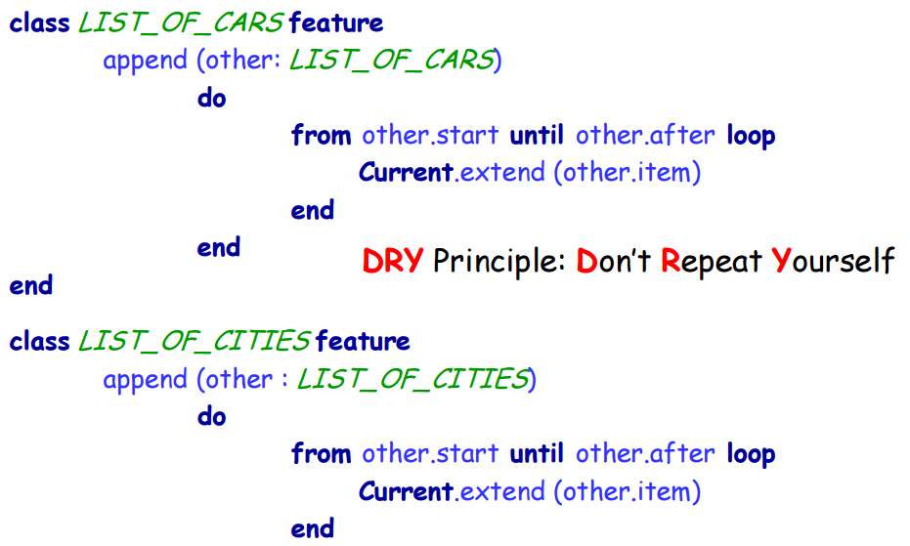
What is wrong with this code (2)?

Slide 9
Possible approaches
1. Duplicate code, manually or with help of macro processor
2. Wait until run time; if types don’t match, trigger a run-time failure (Smalltalk, dynamic type-checking)
3. Convert (“cast”) all values to a universal type, such as “pointer to void” in C (General Purpose Pointer in C: void Pointer)
4. Parameterize the class, giving an explicit name G to the type of container elements. This is the Eiffel approach, also found in recent versions of Java, .NET and others.

Slide 10
In a sad world
Imagine we want to represent a list of cities and a list of people, we would have to write this:
class CITY_LIST
feature
extend (x: CITY)
do … end
item (i: INTEGER): CITY
do … end
class PERSON_LIST
feature
extend (x: PERSON)
do … end
item (i: INTEGER): PERSON
do … end
Can we do better?

Slide 11
What we would like to do
This shouldn’t be so hard! Let’s look again at what we really want:
class _LIST
feature
extend (x: )
do … end
item (i: INTEGER):
do … end
We just want to have a class that has some “holes” in it that we can fill in later with whatever type we like!

Slide 12
How it looks in Eiffel
Let’s not despair: we know how to do this, we’ve done it for years! We just use a parameter, as we would in any other function. Eiffel calls this the formal generic parameter.
class LIST [G]
feature
extend (x: G)
do … end
item (i: INTEGER): G
do … end
Introducing the parameter
f(x) = x + 1
Using the parameter

Slide 13
Generics in practice
Finally, we can do what wanted to begin with, substituting the actual generic parameter for the formal one:
cities: LIST [CITY]
people: LIST [PERSON]
bern: CITY
fred: PERSON
…
cities.extend (bern)
people.extend (fred)
Now:
We have type safety (we cannot put a city into the list of people and vice versa)
We don’t have to write a new LIST implementation for every type of thing we want to put in it.

Slide 14
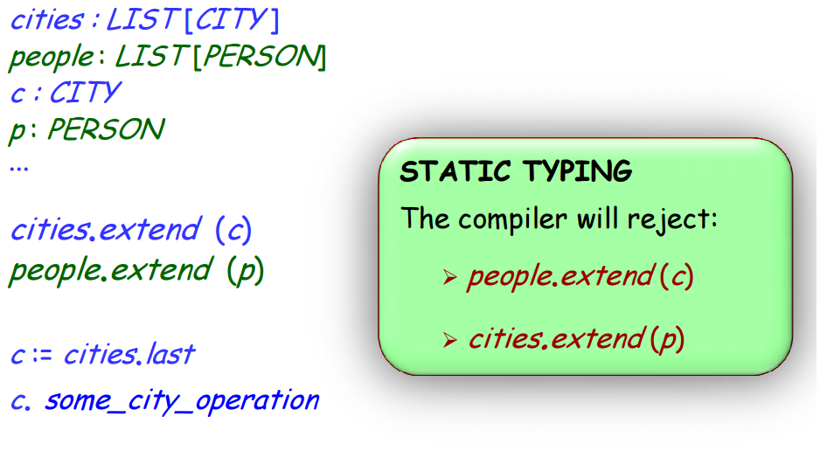
Using generic derivations

Slide 15
Static typing
Type-safe call (during execution):
A feature call x.f such that the object attached to x has a feature corresponding to f
[Generalizes to calls with arguments, x.f (a, b) ]
Static type checker:
A program-processing tool (such as a compiler) that guarantees, for any program it accepts, that any call in any execution will be type-safe
Statically typed language:
A programming language for which it is possible to write a static type checker
Notes:
C is in theory statically typed, but in practice it is possible to bypass the typing system

Slide 16
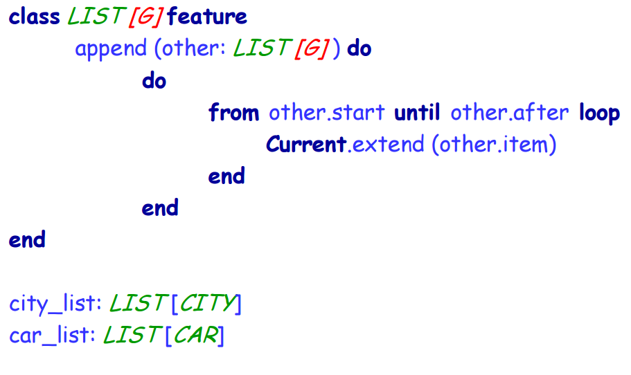
Genericity solution to LIST_OF_...

Slide 17
Constrained genericity (1)
Previously we just had G and it could be anything. Sometimes we only want certain kinds of types to fill that hole.
class SORTED_LIST
[G -> COMPARABLE]
feature
extend (x: G) do … end
item (i: INTEGER): G do … end
sort do … end
This can only be instantiated with a G that is also COMPARABLE, because this is necessary to implement the sort routine.

Slide 18
Genericity + inheritance : Constrained genericity
Constrained genericity does two things for us:
It states that any candidate for substitution for G must conform to class COMPARABLE. Typically this means it must inherit from COMPARABLE
It allows, within the features of SORTED_LIST, the features of COMPARABLE to be applied to any item which has a type of G.

Slide 19
Genericity: summary
Type extension mechanism
Reconciles flexibility with type safety
Enables us to have parameterized classes
Useful for container data structures: lists, arrays, trees,
“Type” now a bit more general than “class”

Slide 20
What we have seen
Basic container data structures
arrays and lists
stacks and queues
tables
For each data structure:
Which operations does it support?
Which operations are efficient and which are slow?
Implementation in a nutshell
There is no one best container: choose the one that matches your problem!
Containers and genericity
Notes:
Genericity lets us:
Have classes that are parameterized by type(s). I.e., we put CITY into a LIST [CITY] the type system tells us we get a CITY back out. If we upcast everything to ANY, ironically, we know nothing.
Write only one class to get the benefits of the above point. We just have to write a single class with a formal generic parameter (“hole”) that we will instantiate with the actual generic parameter later.

Slide 21
Object Oriented Programming (Introduction to Programming) Manuel Mazzara
Lecture 13b: Selective exports
and deferred classes

Slide 22
Abstraction and client privileges
C
A
a1
If class A has an attribute x, what may a client class C do with a1.x for a1 of type A ?
a1 : A
x
a1
x
(C )
(A)
Read access if attribute is exported
a1.x is an expression!
An assignment a1.x := v would be syntactically illegal!
(It would assign to an expression, like a + b := v )

Slide 23
Applying abstraction principles
To provide clients with writing privileges: define a setter procedure, such as
set_temperature (u : REAL) -- Set temperature value to u. do temperature := u ensure temperature_set: temperature = u end
Clients will use calls such as
x.set_temperature (21.5)

Slide 24
Taking full advantage of a setter command
set_temperature (u : REAL) -- Set temperature value to u.
require
not_under_minimum: u >= -273
not_above_maximum: u <= 2000
do temperature := u update_database
ensure temperature_set: temperature = u
end

Slide 25
Exporting (making public) an attribute
In Eiffel, exporting an attribute means exporting it read-only
From the outside, it is not shown as an attribute, just as a query: it could be a function
In C++, Java & C#, if you make public an attribute x, it is available for both read and write:
v := a1.x
a1.x := v
As a result, it is almost always a bad idea to export an attribute.

Slide 26
Getter functions
In C++, Java & C#, the standard technique, if private_x is secret, is to export an associated getter function:
x : T
do
Result := private_x
end
Eiffel needs no getter functions: just export the attribute
This is safe: the attribute is exported
Only for reading
Without the information that it is an attribute: it could be a function (Uniform Access principle)

Slide 27
Having it both ways (Eiffel syntax)
It is possible to define a query as temperature: REAL assign set_temperature
Then the syntax
x.temperature := 21.5
is accepted as an abbreviation for
x.set_temperature (21.5)
Retains contracts and any other supplementary operations
C# has a notion of “property” which pursues the same goal
Not an assignment, but a procedure call

Slide 28
Information hiding
class A
feature
f ...
g ...
feature {NONE}
h, i ...
feature {B, C}
j, k, l ...
feature {A, B, C}
m, n ...
end
Status of calls in a client with a1: A:
a1.f, a1.g: valid in any client
a1.h: invalid everywhere
(including in A’s own text!)
a1.j: valid only in B, C and their descendants
(not valid in A!)
a1.m: valid in B, C and their descendants, as well as in A and its descendants

Slide 29
Information hiding (2)
Information hiding only applies to use by clients, using dot notation or infix notation, as with a1.f (Qualified calls).
Unqualified calls (within class) not subject to information hiding:
class A feature {NONE }
h do ... end
feature
f do ...; h ; ... end
end

Slide 30
An example of selective export
LINKABLE exports its features to LINKED_LIST
Does not export them to the rest of the world
Clients of LINKED_LIST don’t need to know about LINKABLE cells.
count
3
first_element
active
Haldenegg
Central
Haupt- bahnhof
item
right
item
right
item
right

Slide 31
Exporting selectively
These features are selectively exported to LINKED_LIST and its descendants (and no other classes)
class
LINKABLE [G]
feature {LINKED_LIST }
put_right (...) do ... end
right : G do ... end
...
end

Slide 32
LINKABLE
class LINKABLE feature {LINKED_LIST }
item: STRING
-- Value in this cell
right : LINKABLE
-- Cell, if any, to which this one is chained
put_right (other : like Current)
-- Put other to the right of current cell.
do
right := other
ensure
chained : right = other
end
end
Haldenegg
item
right
like Current denotes a type based on the current class (with the same generic parameters if any)

Slide 33
The role of deferred classes
Express abstract concepts independently of implementation
Express common elements of various implementations
Terminology: Effective = non-deferred
(i.e. fully implemented)

Slide 34
Applications of deferred classes
Abstraction
Taxonomy
Capturing common behaviors
High-level modeling, analysis and design

Slide 35
A deferred feature
In LIST :
forth
deferred
end
require
not after
ensure
index = old index + 1
before
after
item
1
count
index
forth

Slide 36
Deferred classes
A class is deferred if it has at least one deferred feature
If so:
It must be declared as deferred class
It cannot be instantiated
with x: LIST,
create x is not possible
(but only e.g. create y.make (…) where y is of type ARRAYED_LIST)
LIST*
LINKED_ LIST ⁺
ARRAYED_ LIST ⁺

Slide 37
Mixing deferred and effective features
In the same class
search (x : G)
-- Move to first position after current -- where x appears, or after if none.
do
from until after or else item = x loop
forth
end
end
“Programs with holes”
Effective!
Deferred!

Slide 38
Programs with “holes”
A powerful form of reuse:
The reusable element defines a general scheme
Specific cases fill in the holes in that scheme

Slide 39
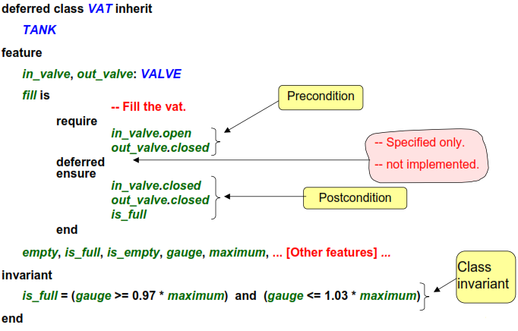
Abstract modeling

Slide 40
What we have seen
Classes define the export status of their features
Queries can be exported
Commands, including setters, can be exported too
Assigner commands give us assignment-like syntax in such cases
Exports can be selective
Deferred classes and features
A powerful mechanism for expressing concepts and their abstract properties independently of any implementation concern

